Slide 1
CUSTOMER ATTRITION PREDICTION MODEL FOR CELL PHONE SERVICE COMPANY
- Submitted by
BHAVIT JAIN

Slide 2
INTRODUCTION
Wireless companies today measure voluntary attrition by a monthly figure, such as 1.9 percent or 2.1 percent.
Attrition prediction is one of the most popular Big Data use cases in business. It consists of detecting customers who are likely to cancel a subscription to a service.
Attrition is a problem for cell phone service companies because it is more expensive to acquire a new customer than to keep your existing one from leaving.

Slide 3
PROJECT OBJECTIVE
To predict Customer Attering.
Understanding of variables.
Missing values treatment in data set.
Data exploration and visualization
Feature engineering
Model evaluation and interpretation
There are many ways: better
products, better delivery
methods, lower prices, building satisfactory customer relationshis, better marketing and, above all, successful customer communications.

Slide 4
DATASET DESCRIPTION
Source dataset is in csv format.
Dataset contains 3331 rows and 14 columns
There are many missing values for the provided input dataset.
Customer_Attrition is the variable which notifies whether a particular customer is Attering or not.
And we will be developing our models to predict.

Slide 5
ATTRITION PREDICTION MODEL
Training data
(5)Update
(!)Build
Real
independent
Model
(4)Predict
(2)Test
Testing data
(3)Test=Ok

Slide 6
METHODOLOGIES
EDA(Exploratory Data Analysis): The dataset consists of 12 variables in all. A few are categorical (3) , rest are continuous. The control variable was customer.
Model building which includes defining the purpose if model, determine the model boundary, build the model, create an interface and export the model.
Evaluating machine learning algorithm is an essential part of project.

Slide 7
EXPLORATORY DATA ANALYSIS
Data visualisation using seaborn and matplotlib
Exploratory data analysis (EDA) is an approach to analyse data sets & to summarize their main characteristics, often with visual methods.
A Statistical model can be used or not, but primarily EDA is for seeing what the data can tell us beyond the formal modelling or hypothesis.

Slide 8

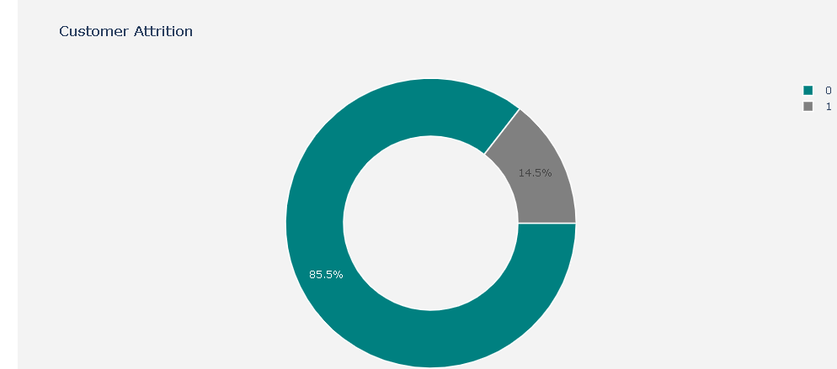
Customer_Attrition column Visualisation
Pie-Chart:
Pie-chart that the Users from the Data are likely to be Continuing their Subscription plan(>85%)

Slide 9
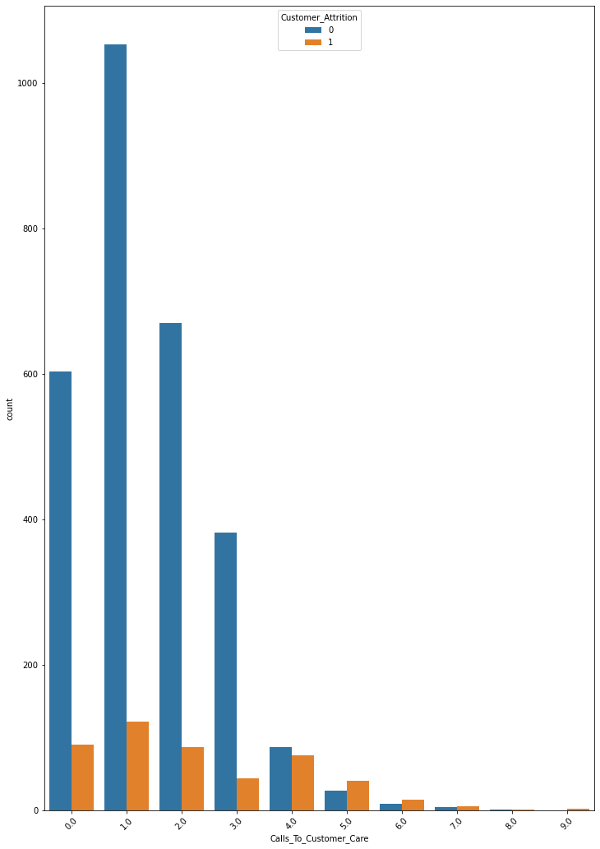
COUNT PLOT:
We found people who call less to customer care are high chances on attrition.

Slide 10
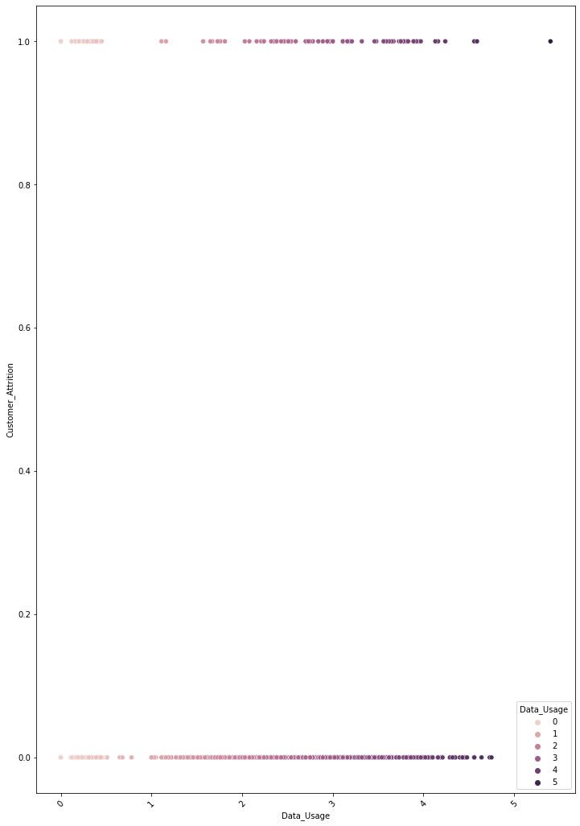
SCATTER-PLOT
Visualize Customer_Attrition Rate by Data_Usage
Customers utilising more data are not less likely on attrition.

Slide 11
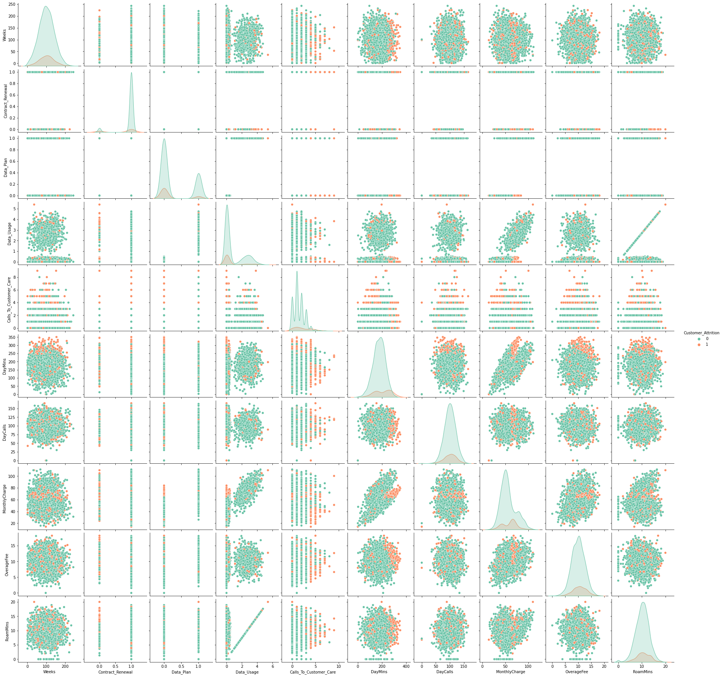
Visualising Every Feature by Pair-Plot
PAIR-PLOT :
It is a scatterplot of each numeric column with all other numeric columns including itself.
We see that those who have more day calls , calls less to customer care. And those who have charged more Overage fee are more on attrition.
And those who have less roam mins are not in attrition. Those who have more monthly charges is more on attrition

Slide 12
ACCURACY OF SUPPORT VECTOR MACHINE MODEL
MODEL | ACCURACY
Support Vector Machine | 86.62%

Slide 13
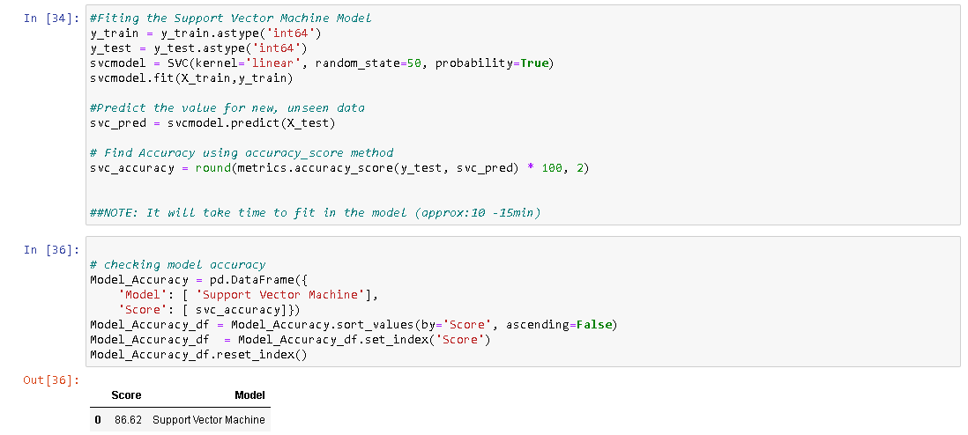
SVM MODEL

Slide 14
METRICS EVALUATION:
CONFUSION MATRIX:
841 | 14
119 | 20
ACCURACY: 86.62%

Slide 15
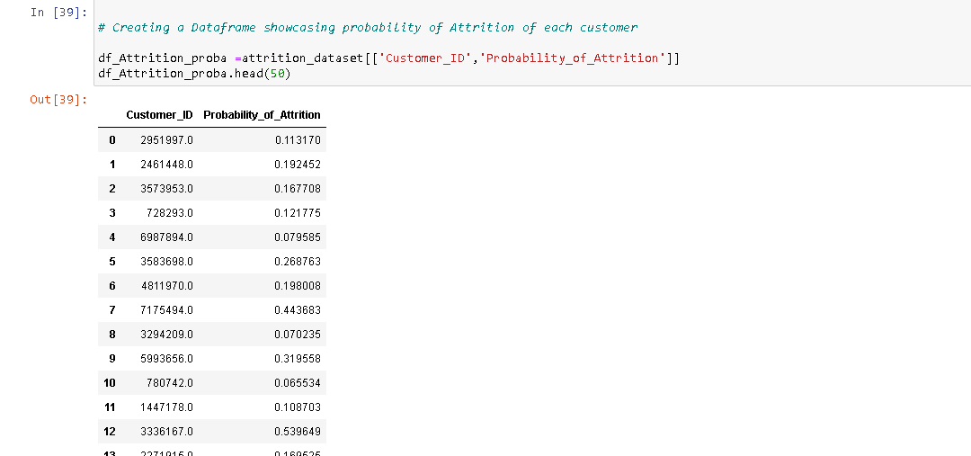
Predict the Probability of Attrition of each Customer

Slide 16
FINDINGS AND SUGGESTIONS
Try to offer the better service for the attering customers ,see how much this impact before and later .Some may use your service better move them to your active customers.
Take the feedback and suggestions with in period of time and improve it ,strive for better communication.
When your are taking the any change in plans of your business just predict the positive and negative share of that plan. If it is negative prepare the solution before so You can handy easily.

Slide 17
HOW TO REDUCE CUSTOMER ATTRITION
Lean into your best customers.
Be proactive with communication.
Define a roadmap for your new customers.
Offer incentives.
Ask for feedback often.
Analyze attrition when it happens.
Stay competitive.

Slide 18
CONCLUSION
The importance of this type of Models predivtion and analysis is to help companies make more profit.
It has become known that predicting Attrition is one of the most important sources of income to Cell phone service companies.
Hence, this research aimed to build a system
that predicts the churn of customers cell phone service company.
These prediction models need to achieve high AUC values. To test and train the model, the sample data is divided into 70% for training and 30% for testing.

